Slide 1
You’re Not Wanted Here!
Joelle Tori Maslak - JMASLAK
How design decisions can make your application discriminatory
The Perl Conference 2018 Salt Lake City, UT, USA

Slide 2
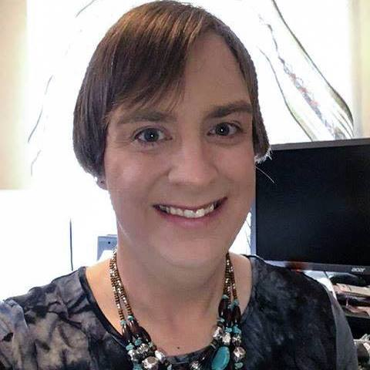
Who Is Joelle?
Perl Developer since 1995
First Program Written: 1982 (it displayed her name – that’s important to a five year old girl!)
First Unix: A/UX (not a typo)
First Linux: Slackware 1.1
First CPAN Module: Acme::Unicodify
First useful CPAN Module: Parallel::WorkUnit
She has a lot of opinions. They are hers, not her employer’s!

Slide 3
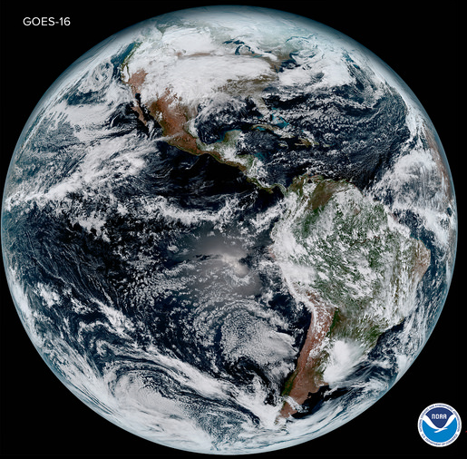
Why Discriminatory Design Happen?
Designing for the 100% - or even 5% - is hard. The 2% is easy!
USA residents are 4.3% of the world population (UN)
Approximately 8% of people in the USA say they do not speak or write English well (US Census Dept)
Approximately 25% of American adults have zero credit cards
30% of Americans have no internet at home
.043 × .92 × .75 × .70 = 2.1%

Slide 4
We Only Do Business in the USA!
And by that, we mean…

Slide 5
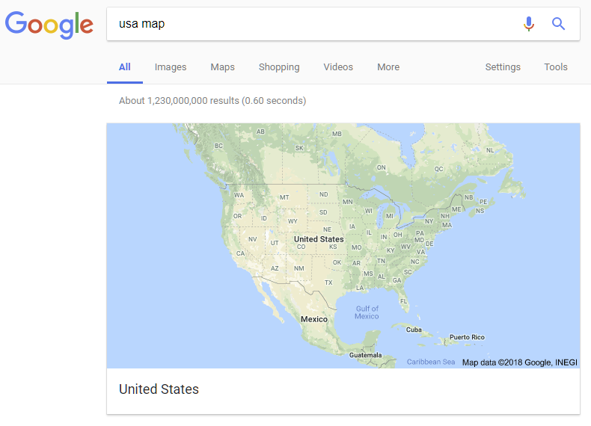

Slide 6
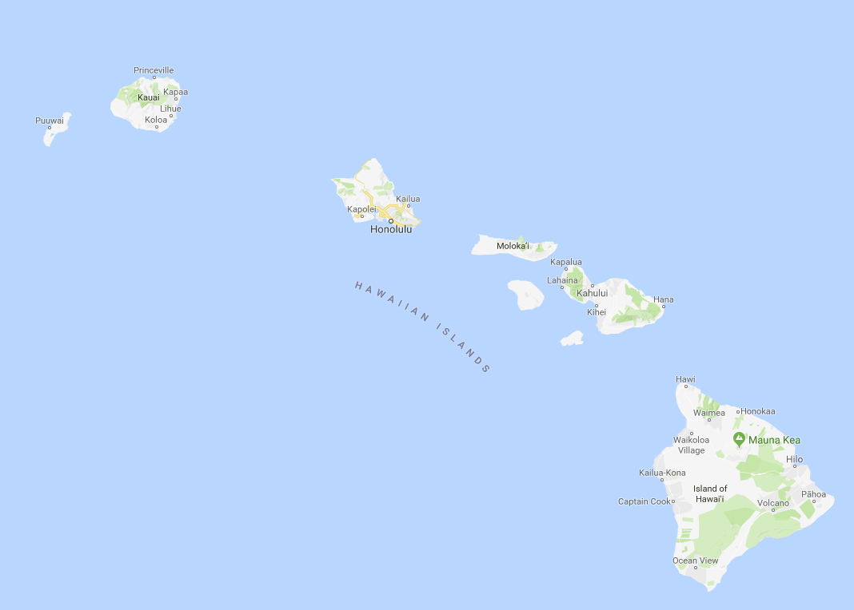
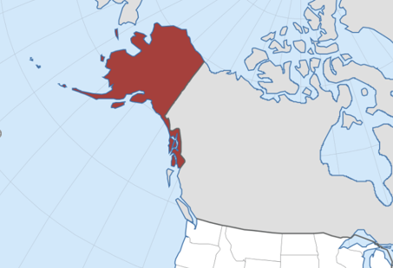
Not These People

Slide 7
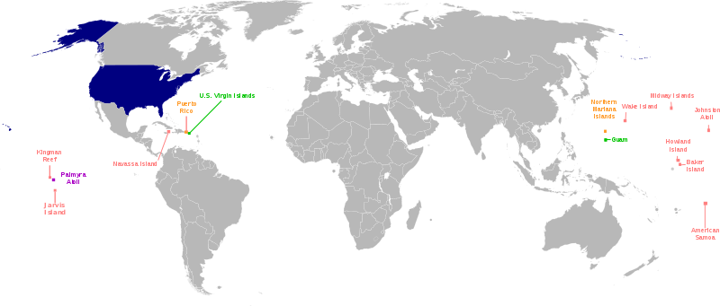
Definitely Not All of These

Slide 8
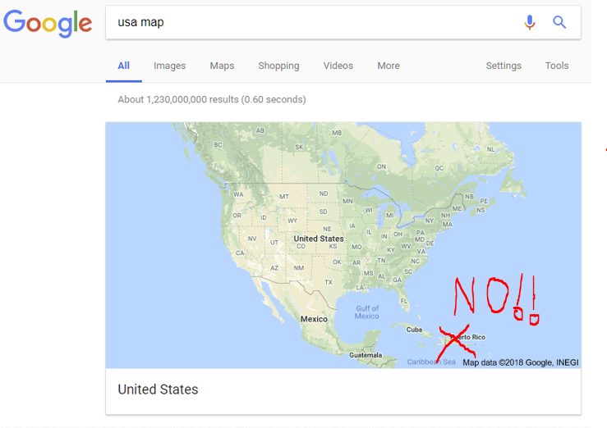

Slide 9
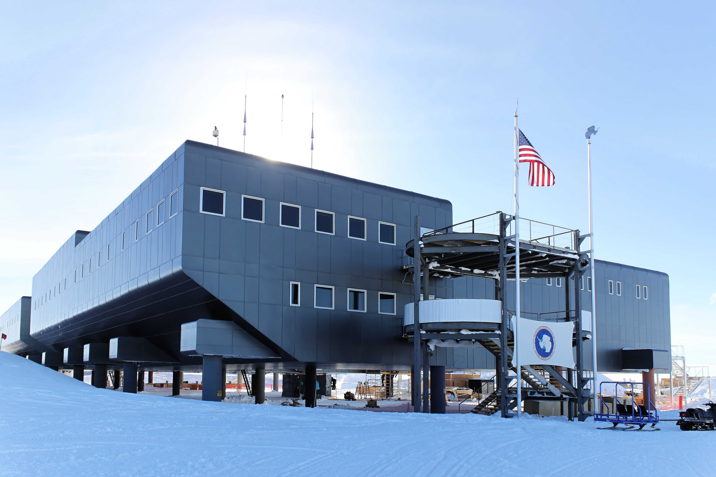
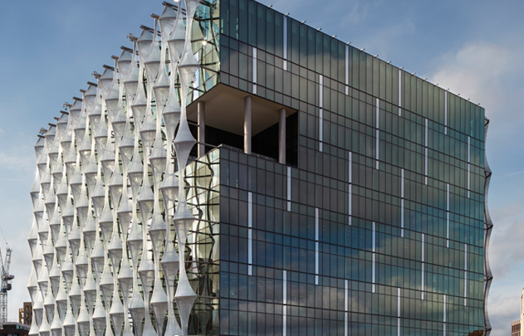
Yes, USA only. Not these people.
Notes:
The point is, even limiting your app to “Americans”, you still needs to consider diversity.

Slide 10
Not Just Geography…

Slide 11
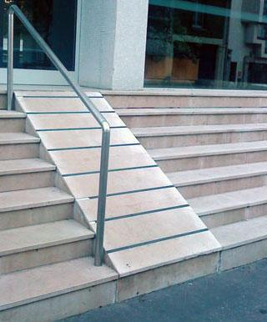
Including People With Physical Disabilities
Don’t require extensive use of mouse-based navigation (allow keyboard alternatives)
Minimize scrolling
Touch or mouse targets should be large
Eliminate timeouts on forms
Back button & refresh should not reset everything
Different physical disabilities require different interfaces!

Slide 12
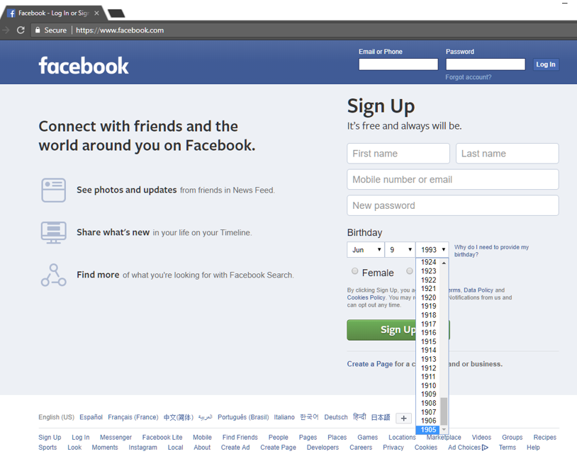

Slide 13
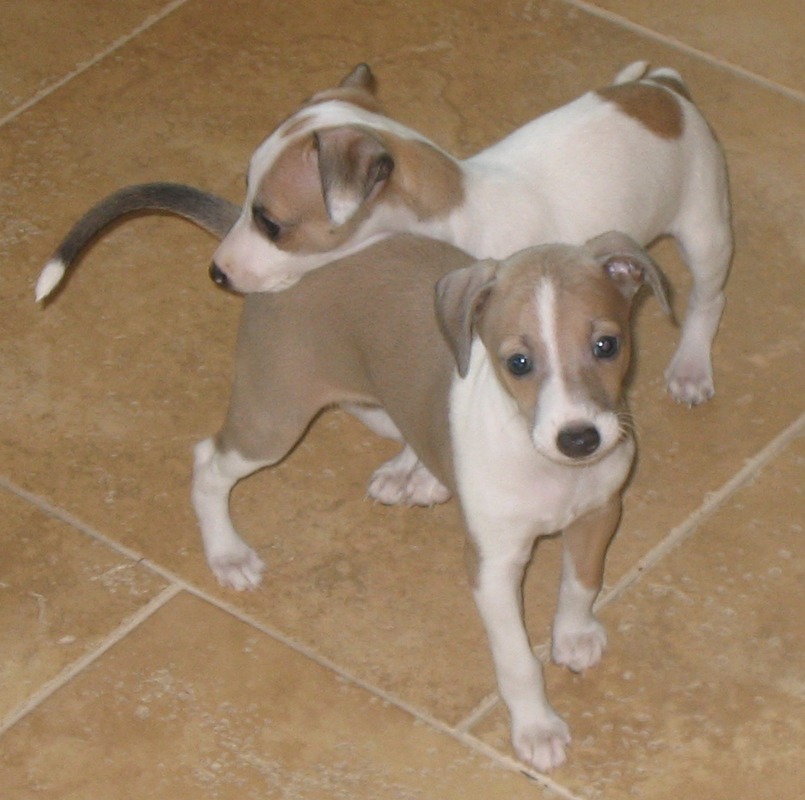
Include All Ages
Age of majority is not always 18.
101 year-old people also use computers!
Different age groups use different technology
25 year-old developers can often read fonts 50 year-olds cannot
Security questions should not assume youth

Slide 14
But nobody that old uses my site…

Slide 15
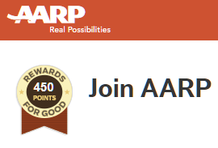
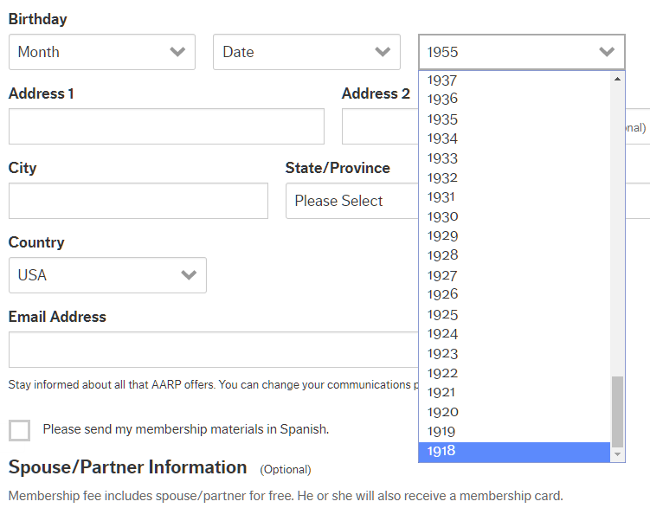
Notes:
American Association of Retired Persons

Slide 16
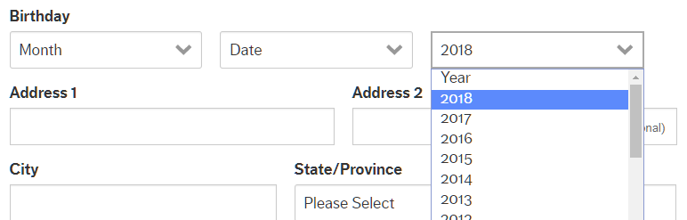
Never Too Young For That Senior Discount!

Slide 17
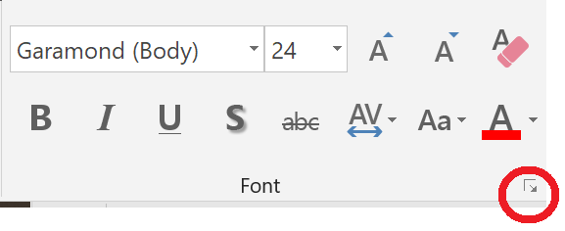
Computer Knowledge
What does “…” mean?
What does “+” and “-” mean?
GUIs are always more friendly, right?

Slide 18
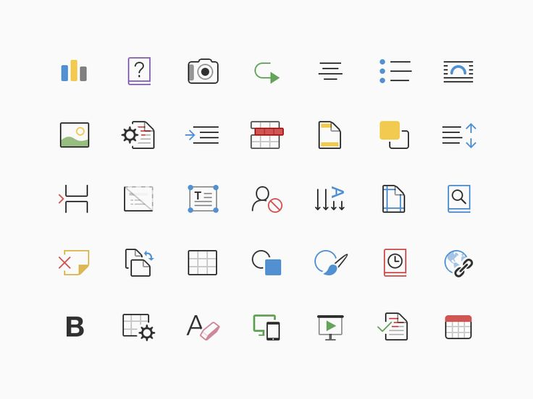

Slide 19
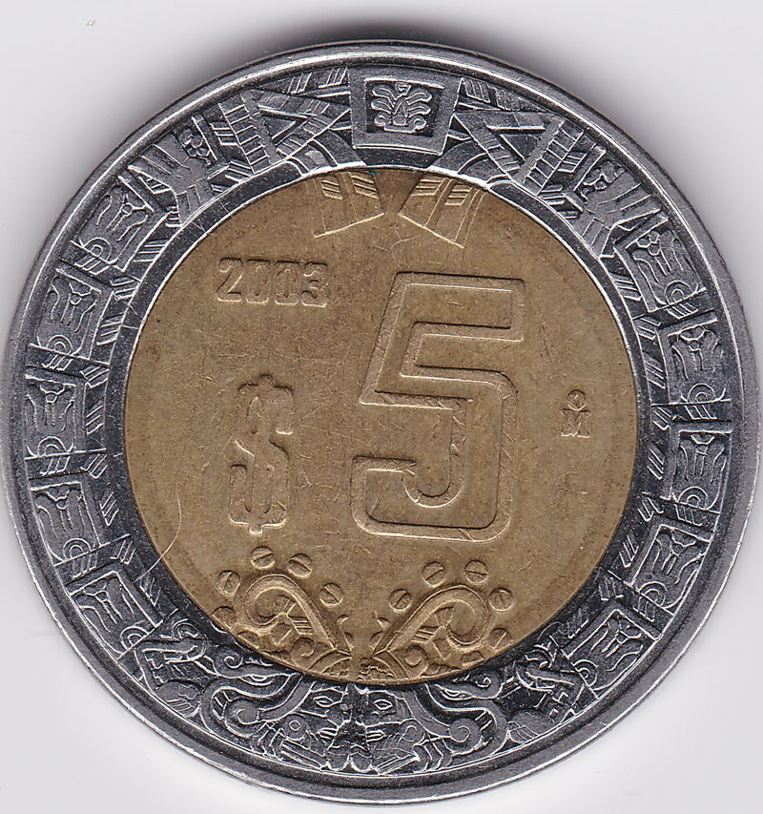
Financial
Don’t assume everyone has …a credit card …a cell phone …a bank account …a home address
Not all credit cards have a chip & PIN
Postal codes have more than one format

Slide 20
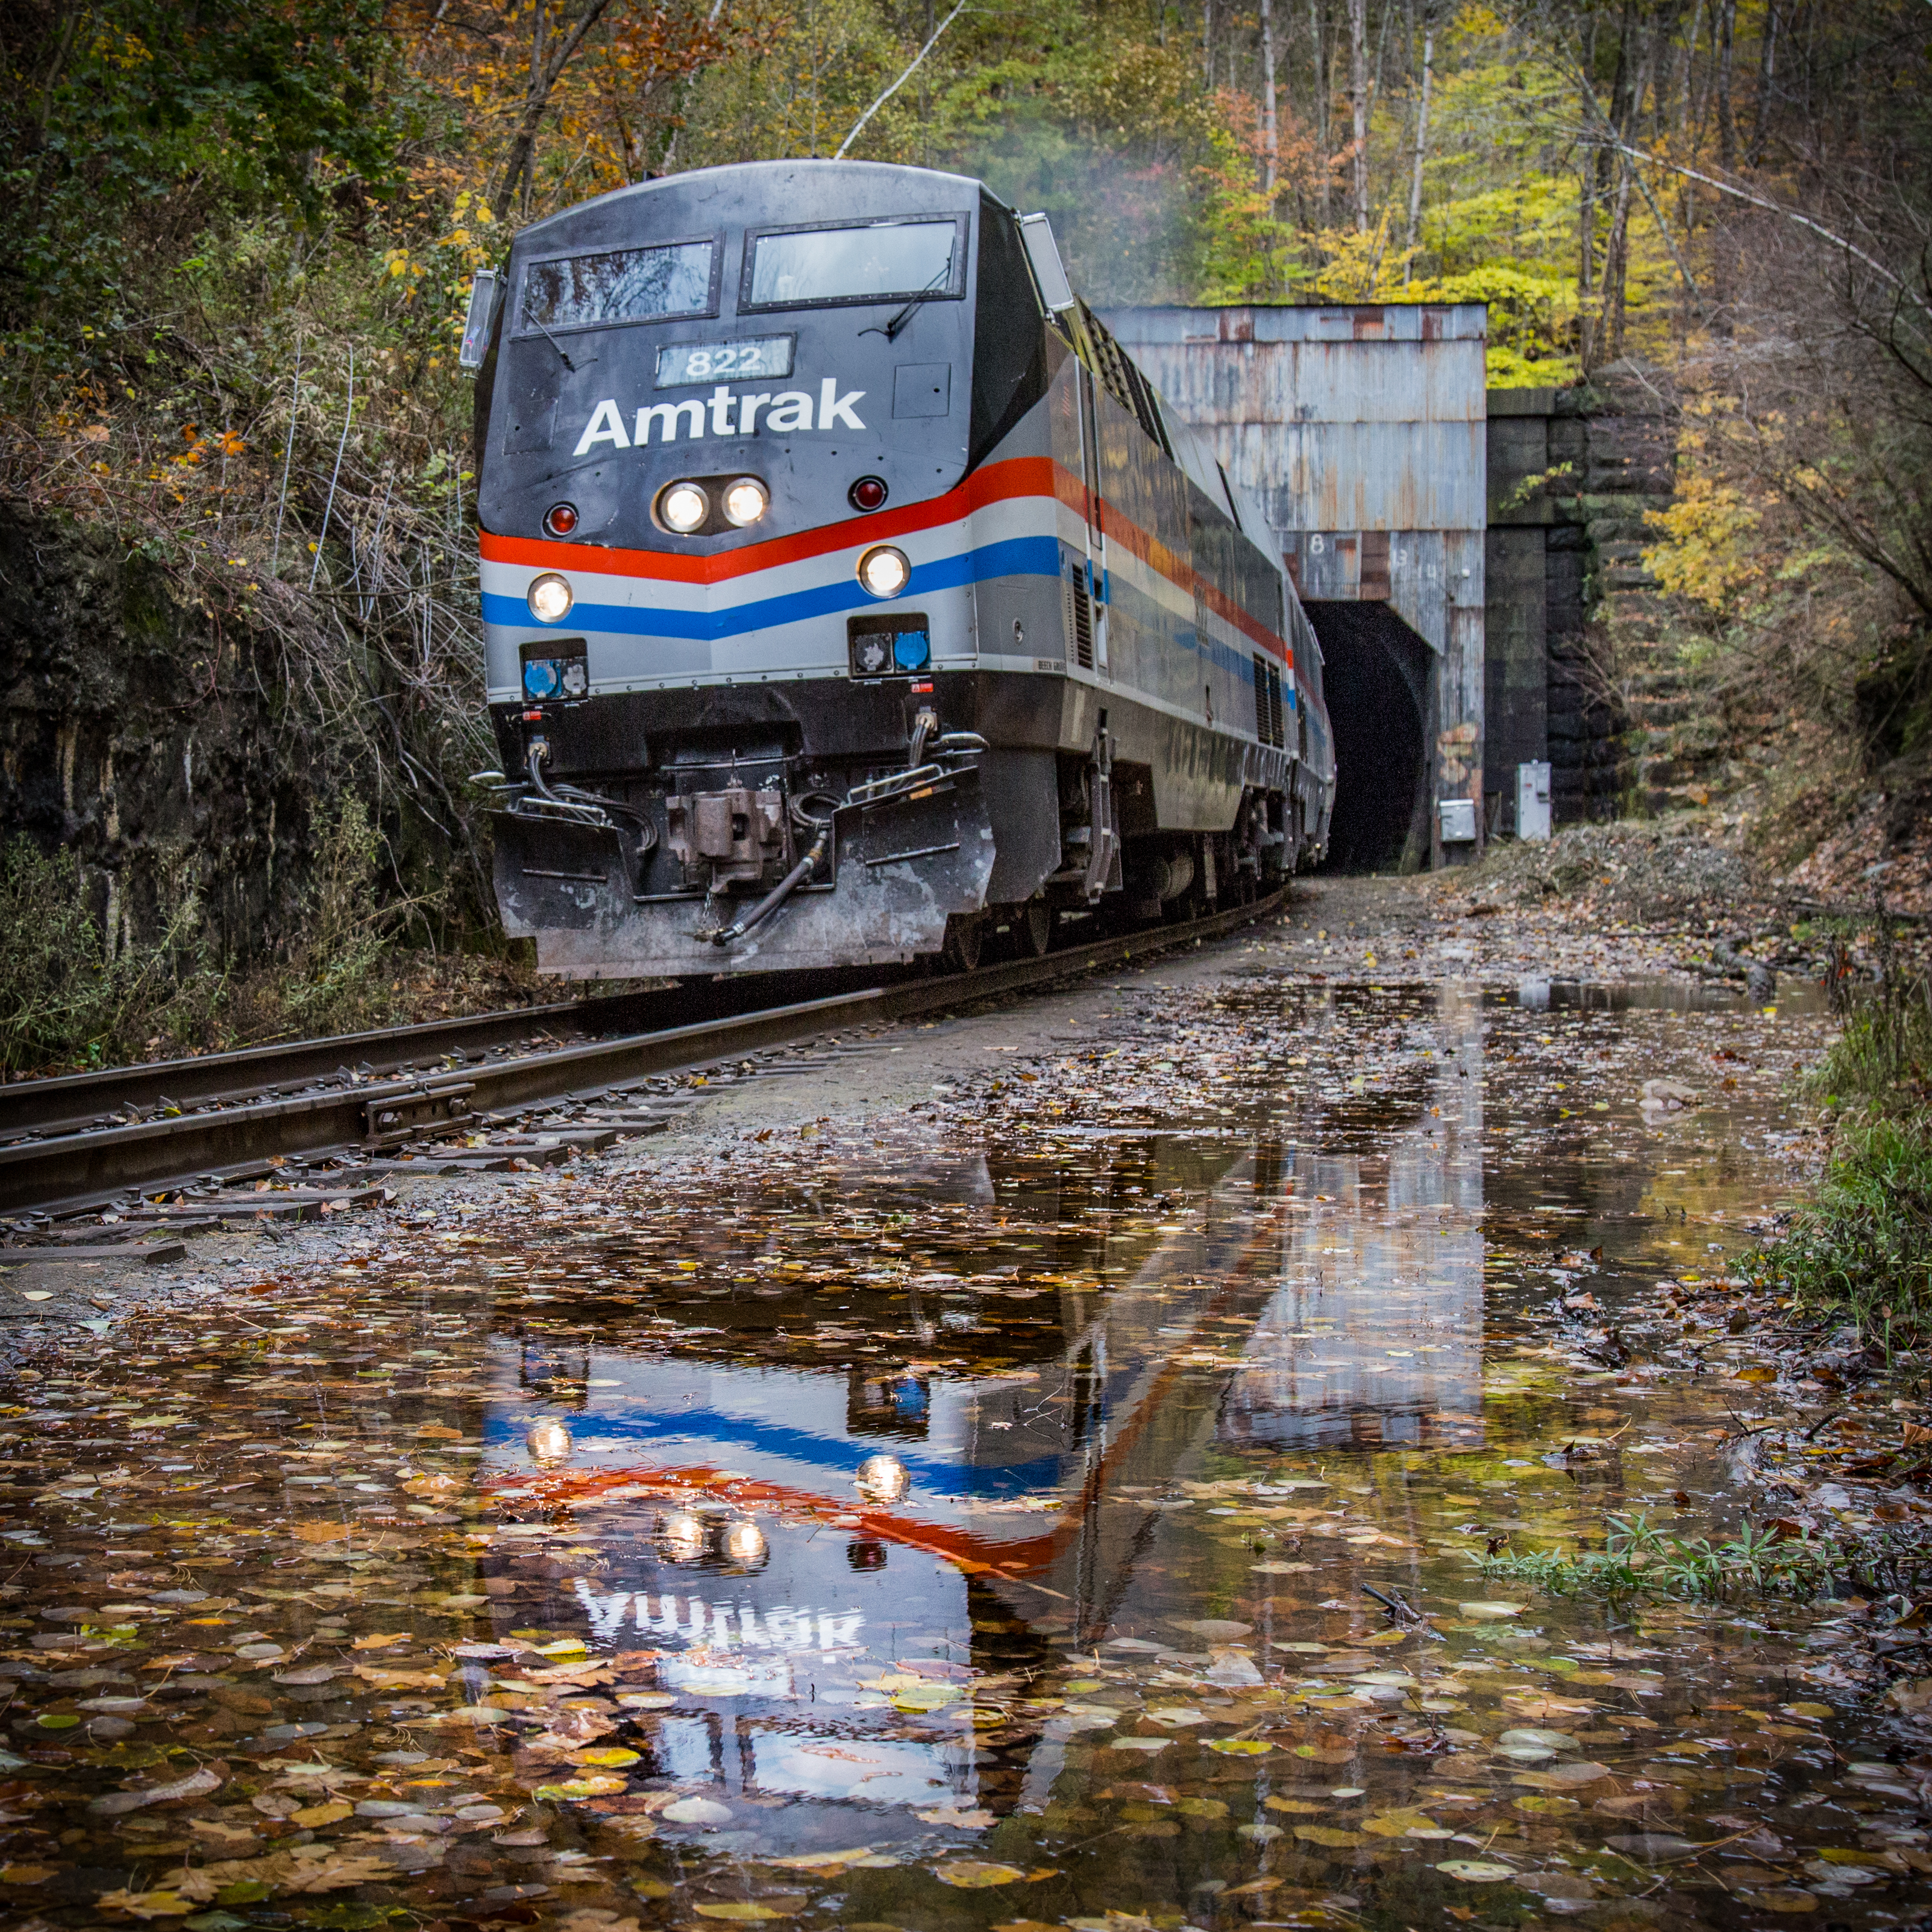
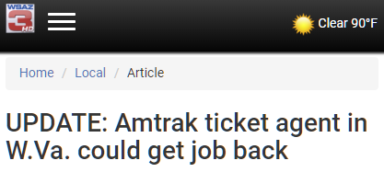
Case Study - Amtrak
Everyone buys tickets online, right?
Everyone wanting tickets has a credit card, right?
Everyone has internet access these days, right?

Slide 21
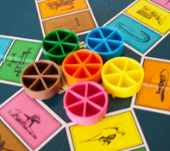
Sensory Disabilities
Don’t require typical vision
Use good contrast
Avoid small fonts
Use alt tags
Use captions for audio
Avoid color as the sole way of conveying information

Slide 22
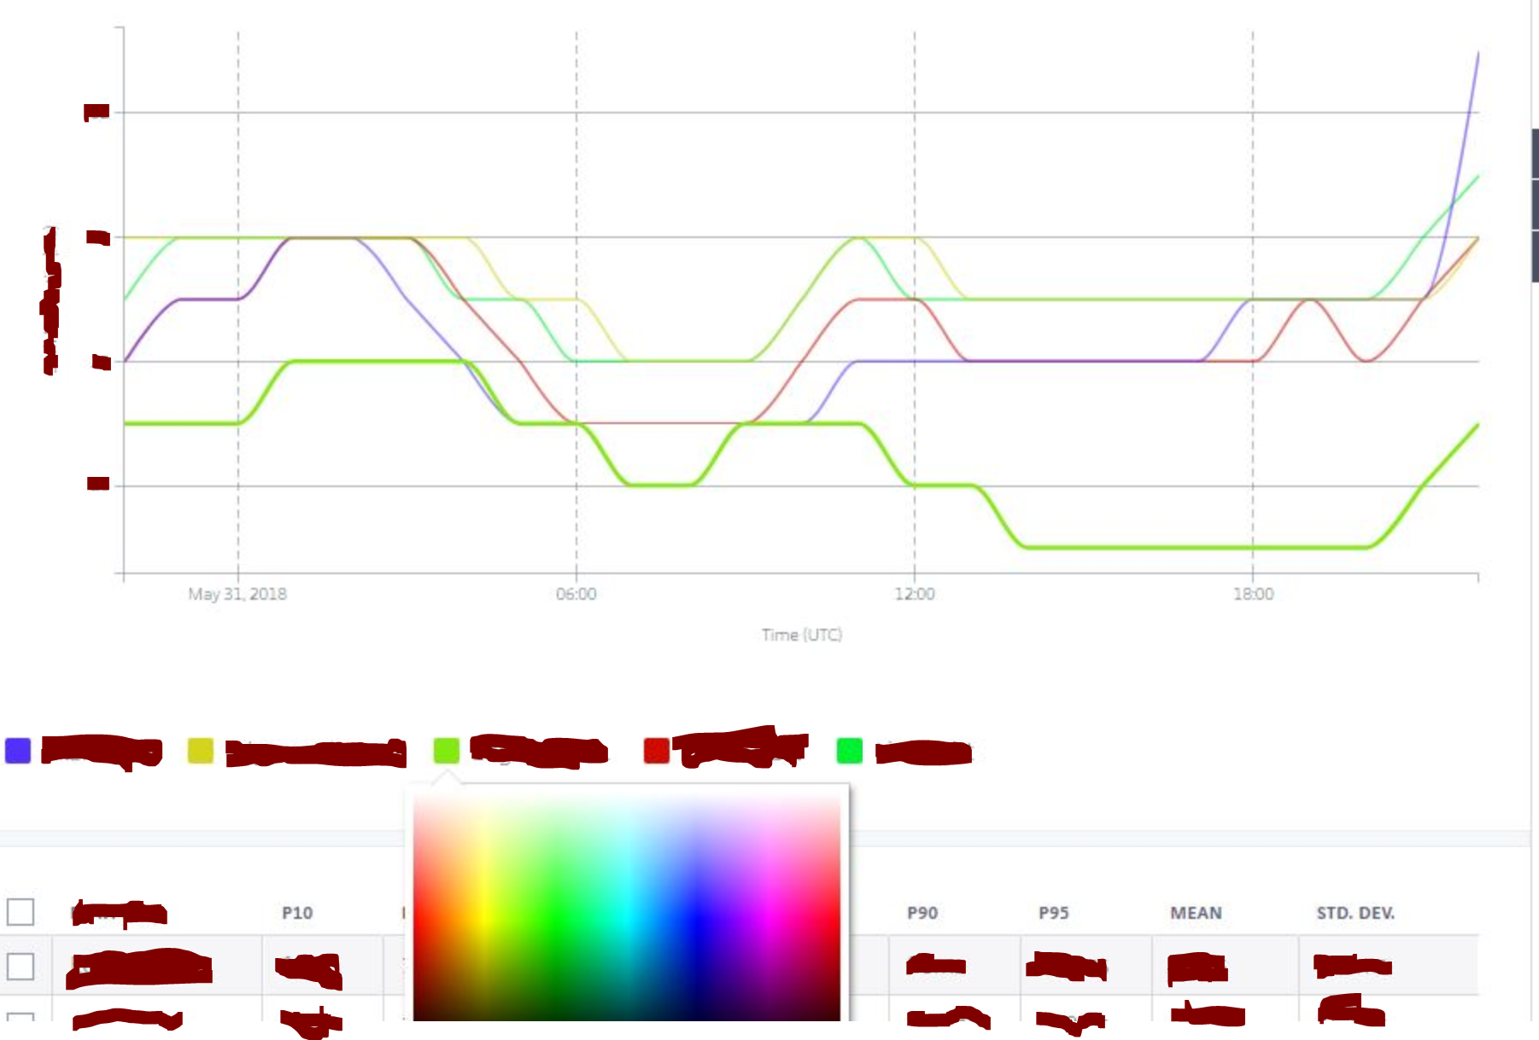

Slide 23
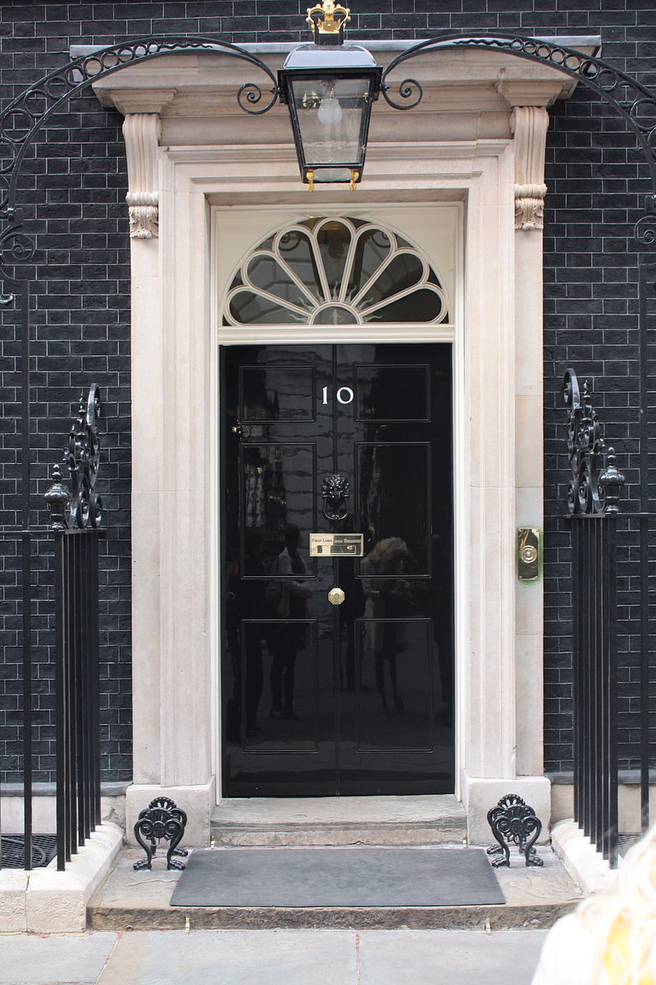
Addresses
You can’t map people to 2D space (the vertical matters!)
Addresses don’t all have the same parts – a “street” for instance.
N lines are insufficient for an address (for small values of N)
Street, city, and building names change
Allow new construction!
(at least in USA) Don’t infer city from postal code

Slide 24
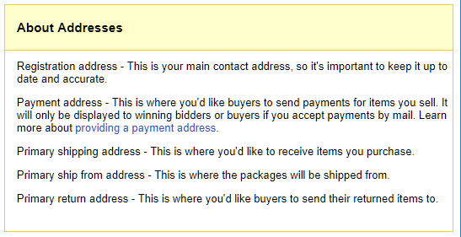
And people move!

Slide 25

Knowledge
Tell people where to find information they need to enter
Define acronyms
Avoid industry terms “Enter ABA Routing Number,” “API,” and “Avatar”.
Make it easy to file bugs or use a support form!
Don’t exclude newcomers!

Slide 26

Bad Knowledge Example 1: DNS & Bind
Context: Hostname request system at a large enterprise. “If you don’t know how to fill out this form, please consult DNS & BIND by Albitz & Liu, 5th Ed, Feb 2009.”
A link was provided to the organization’s library catalog. There was no online references provided.

Slide 27
Bad Knowledge Example 2: Bug Trackers
Calls bug reports and feature requests “tickets”
Makes the user select from a confusing list of categories
Requires an understanding of the internals to file a report.
Best of all, suggest new users “contribute” by filing bug reports!
You’ll ignore the severity they enter, but ask anyhow!
For bonus points, severities should be numbered 1 through 8.

Slide 28

Gender
Don’t collect it when you don’t need it.
Gender is not fixed, binary, or immutable, and is sometimes accidentally entered wrong.
Allow people to change gender without calling support
Designs statistically preferred by men are considered “professional” by men. Be careful with this bias!

Slide 29
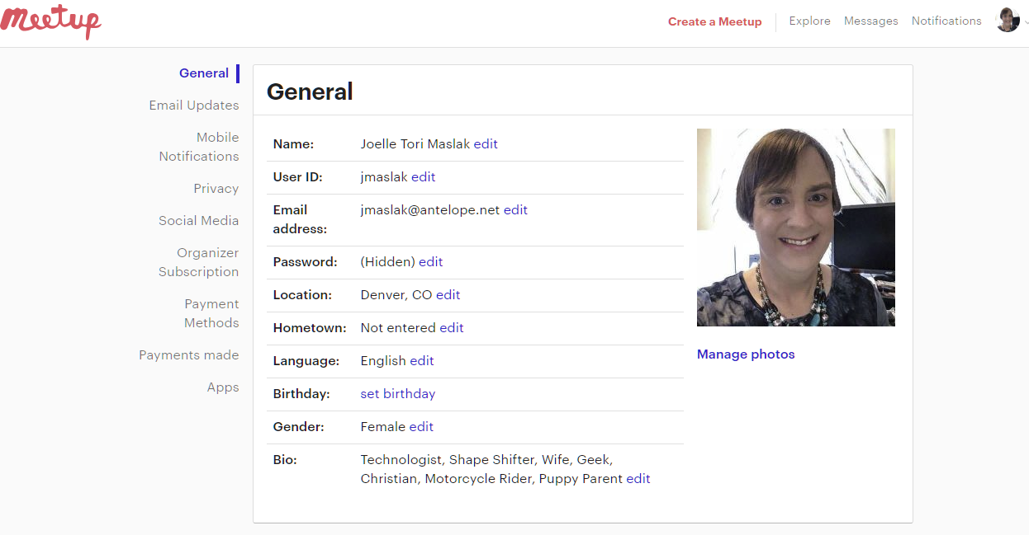

Slide 30
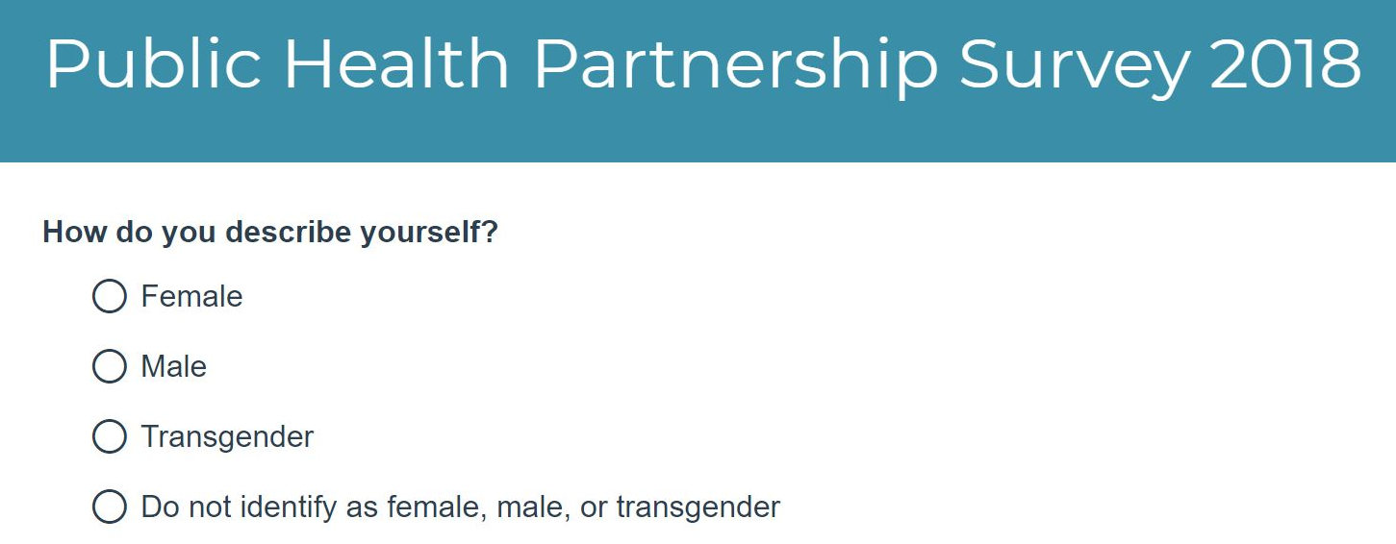
Asking for Gender

Slide 31
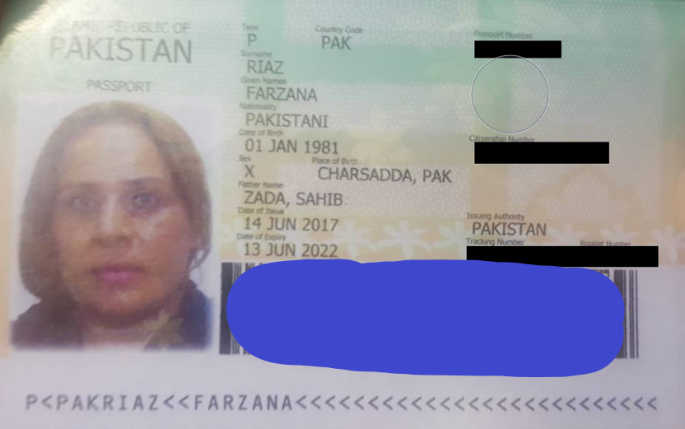
Notes:
This person’s legal sex is neither M or F. Pakistan is one of many countries that allow an X on passports and identity cards.

Slide 32

Notes:
… A logo can be appealing to seven year old girls! Avoid the trap of associating professional with male.

Slide 33
Numbers & Dates
Dates have local formats – MM/DD/YYYY vs. DD/MM/YYYY
Numbers, too – one hundred thousand is not always written 100,000
Sometimes 100.000
Or 1,00,000
Or ١٠٠٠٠٠

Slide 34
But…I Don’t Care! Don’t worry, Perl does!
A possible trap – this will say it is a number and print the string: if ('١٠٠٠٠٠' =~ m/^\d+$/) { say "١٠٠٠٠٠ matches"; }
Output:
١٠٠٠٠٠ matches

Slide 35
From the Docs
From perlre –
“The /d, /u , and /l modifiers are not likely to be of much use to you…”
“The /a modifier, on the other hand, may be useful.”

Slide 36
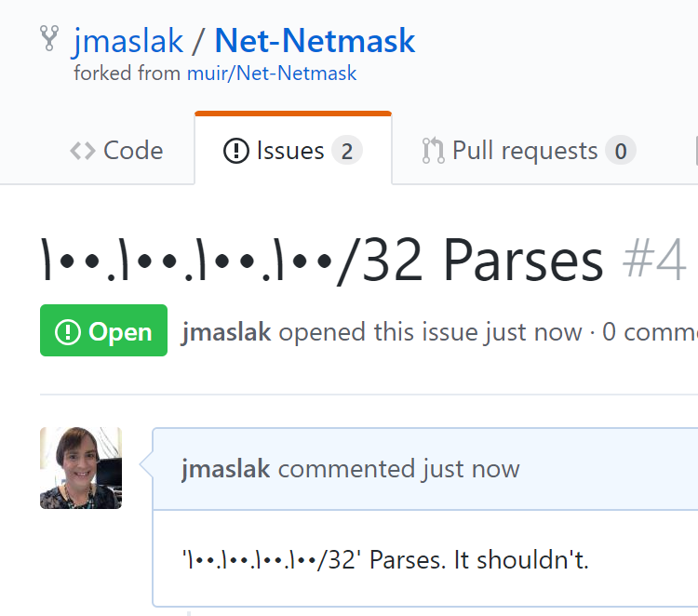

Slide 37
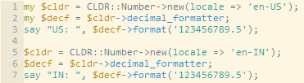
Perl Modules to Use …when making non-discriminatory apps…
DateTime::Format::CLDR
CLDR::Number -
Notes:
Unicode Common Locale Data Registry

Slide 38
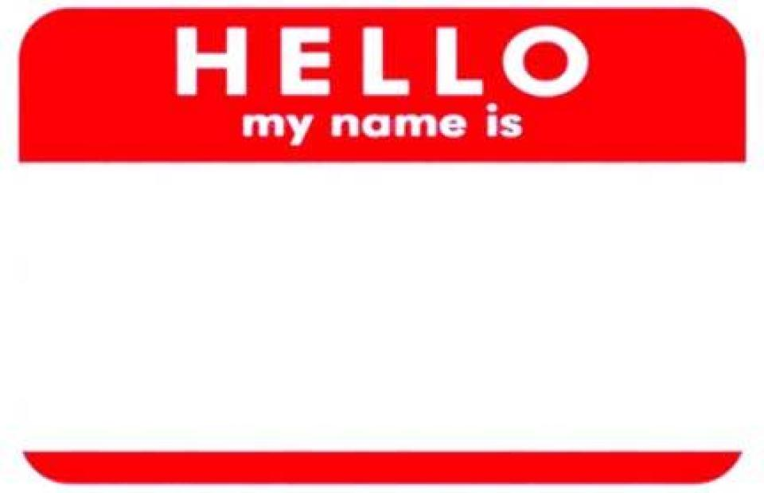
Names
“first name” doesn’t mean given name and “last name” doesn’t mean family name
Some cultures don’t prefer <title> <lastname>
“Ms. Gunnarsdóttir”
Allow nicknames and other non-legal names if possible
Explain why you need the name
Use of middle initials is culturally dependent
Don’t assume two names, or even three when you want a middle initial. One blank!
Don’t use name to link databases

Slide 39
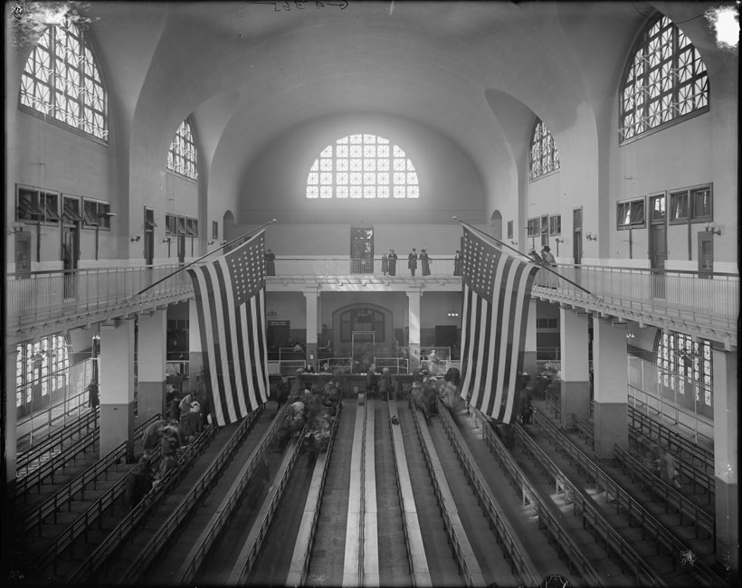
More Names
Allow apostrophes, hypens, and spaces in names
Mr. O’Malley
And accent marks
José – he’s not Jose.
John Smith Sr. and John Smith Jr. might both use your system

Slide 40
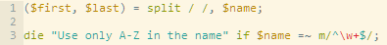
Bad Example Perl Code
Notes:
\w+ matches characters like an e with an accent – José will validate.

Slide 41
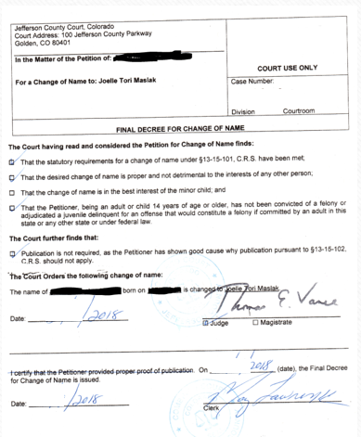
Names – Make it Easy to Get Married!
Names don’t stay the same for life
Usernames change –jdoe marries Mr. Smith and becomes jsmith.
If you store multiple names/addresses, ask if the user wants to change them all.
Don’t require everyone to have specific documentation of legal name changes
Notes:
Did you know you can legally change your name simply through usage in some places?

Slide 42
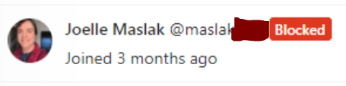
Don’t Link Databases with Username
OLD USERNAME
Notes:
This is from Gitlab – it linked to the corporate directory based on username. Note it gets bonus points for not explaining why it is blocked.
Women get married and often change their name in many countries

Slide 44
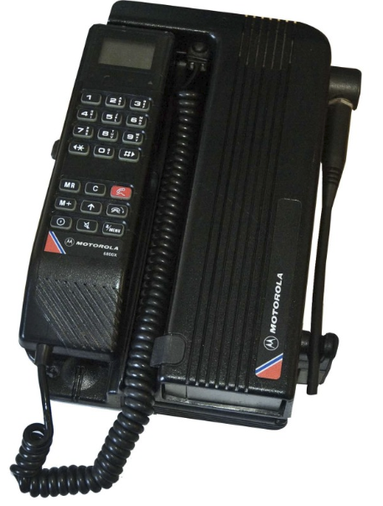
Phone Numbers
Allow out-of-country phone numbers
Not everyone has cell coverage
Let the computer format the number
You want 5555551212 entered, not 1-555-555-1212 or (555) 555-1212 – Perl is awesome and can munge text!

Slide 45
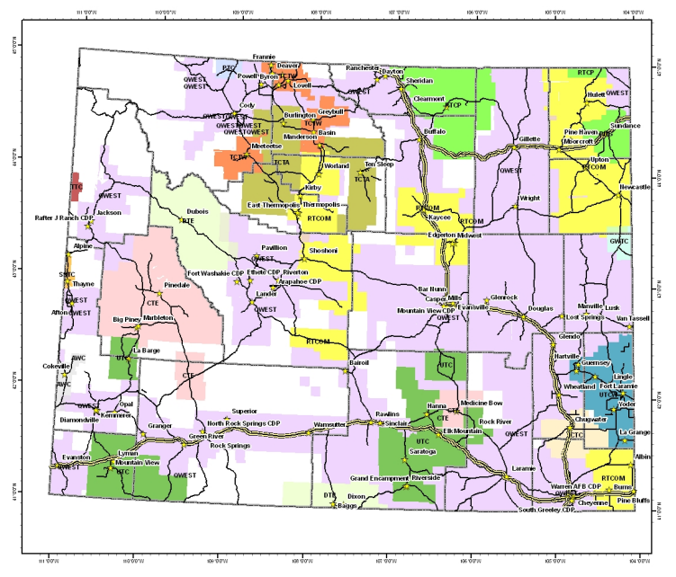

Slide 46
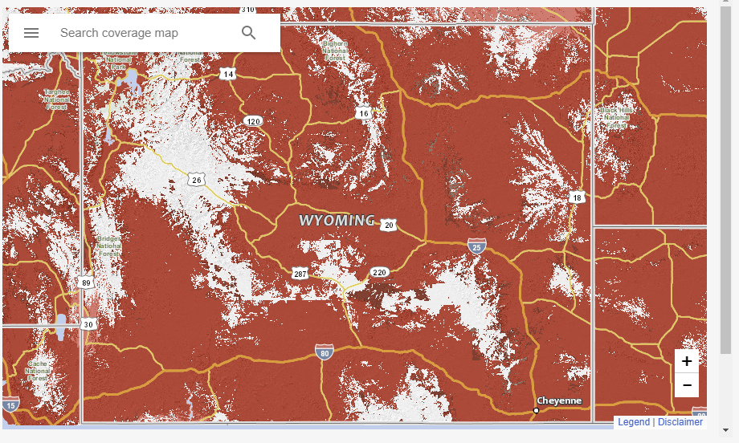

Slide 47
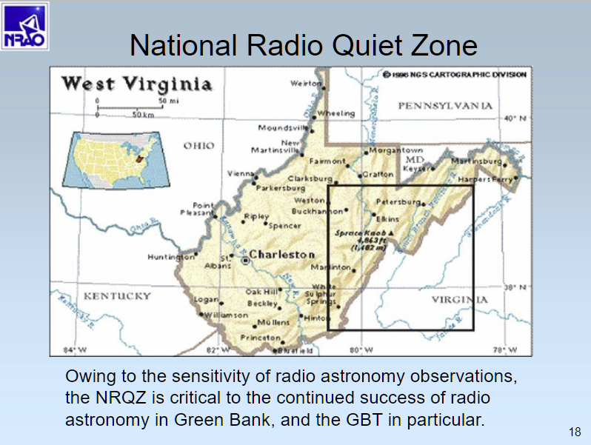

Slide 48
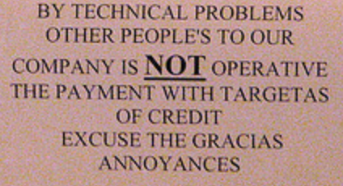
Language Usage
Notes:
Your app’s language(s) might not be someone’s first language.

Slide 49
Okay, a better bad example:
iTunes user agreement – an awesome example of 56 pages of useless information, such as:
If you are a qualified public educational or government institution and any part of this Agreement, such as, by way of example, all or part of the indemnification section, is invalid or unenforceable against you because of applicable local, national, state or federal law, then that portion shall be deemed invalid or unenforceable, as the case may be, and instead construed in a manner most consistent with applicable governing law.
Notes:
I’m not actually sure if I’m allowed to copy that term and condition since I’ve agreed to the iTunes terms and conditions, apparently.

Slide 50
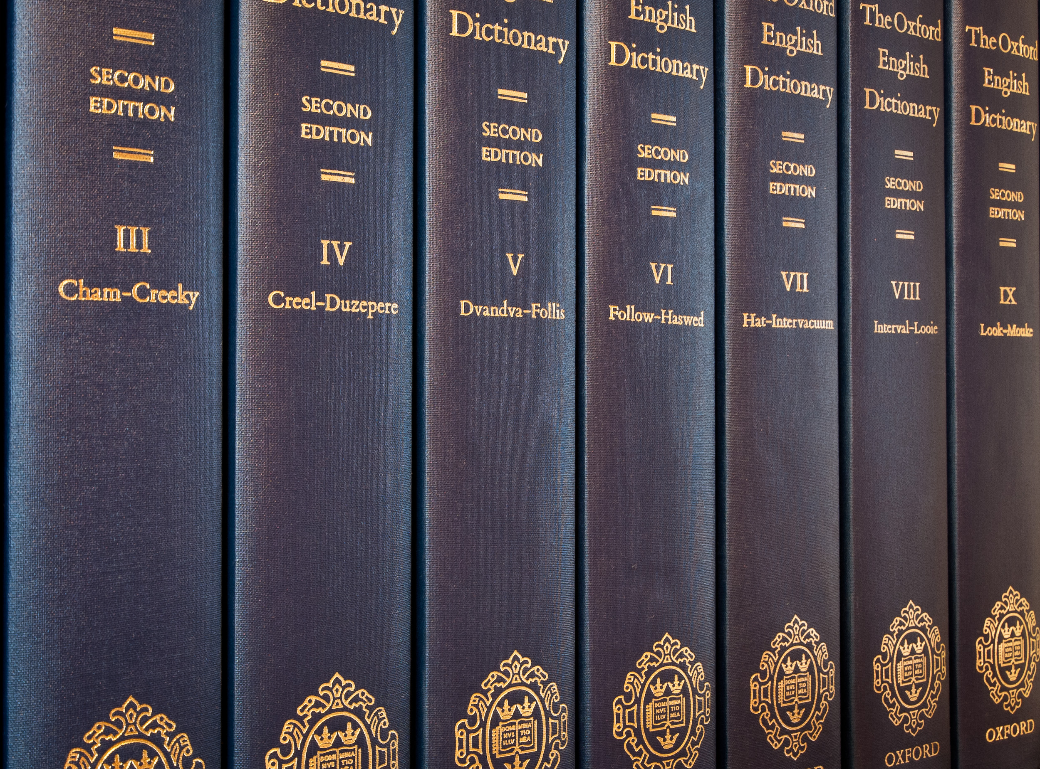
Language Usage
Your language might not be their first language
Avoid idioms and complex figures of speech
Use simple vocabulary
Avoid assumptions that are cultural-specific. Not everyone knows what a “Safeway” store is!

Slide 51
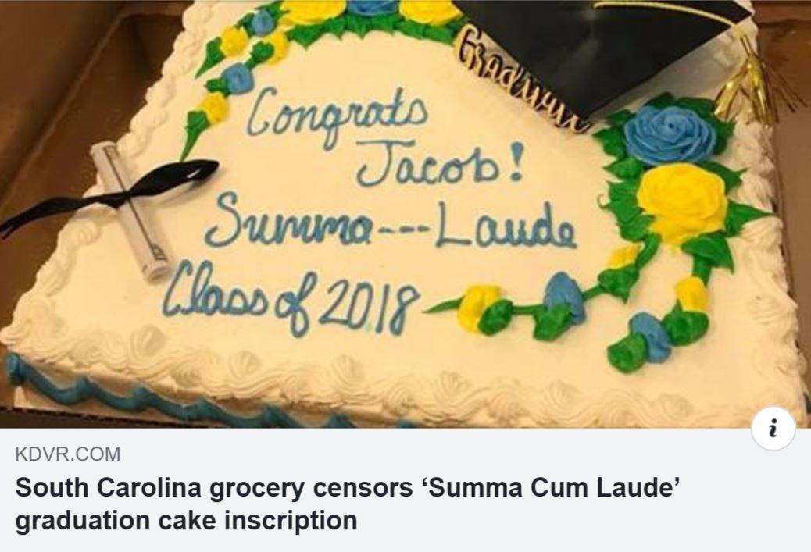
Profanity Filters can be Problems!

Slide 52
What if I want to be inclusive?
Respect what people tell you (names, addresses)
Consider how universal a “universal” tech is (cell phone, high speed internet)
People don’t always fit into boxes. Be able to handle that.
Beware of samples of convenience in focus groups
Reach out to minority communities
Respond to failure quickly – but think before you do!

Slide 53
THANK YOU!
Contact Info –
Joelle Maslak <jmaslak@antelope.net>
CPAN: JMASLAK

